Slide 1




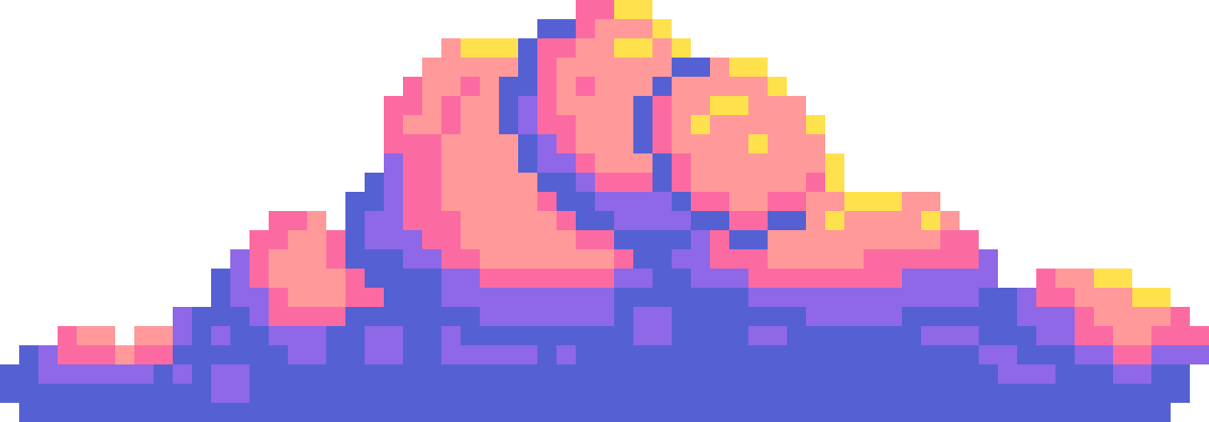

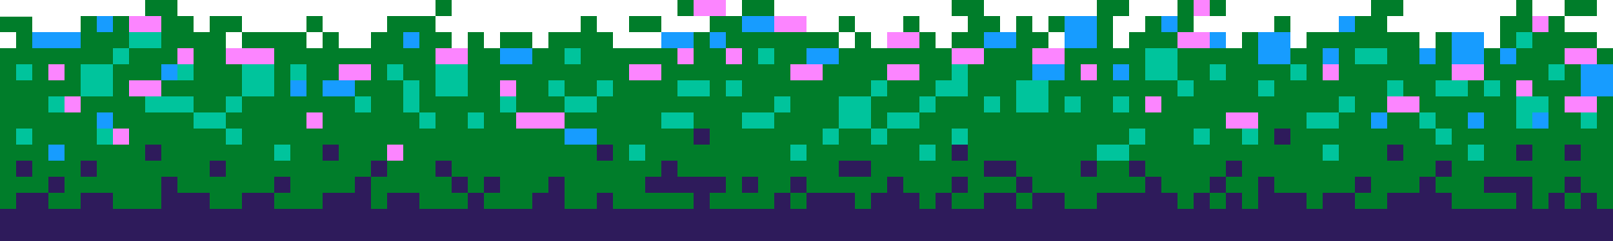
ADVANCED PROGRAMMING
GUESSING GAME
AHMED ZAYTOUN
SEIF HAYTHAM
ABDELRAHMAN GOMAA
23-101329
23-101282
23-101279
ZYAD MOHAMED
MOATAZ HINDY
HASSAN AHMED
23-101280
23-101290
23-101330

Slide 2
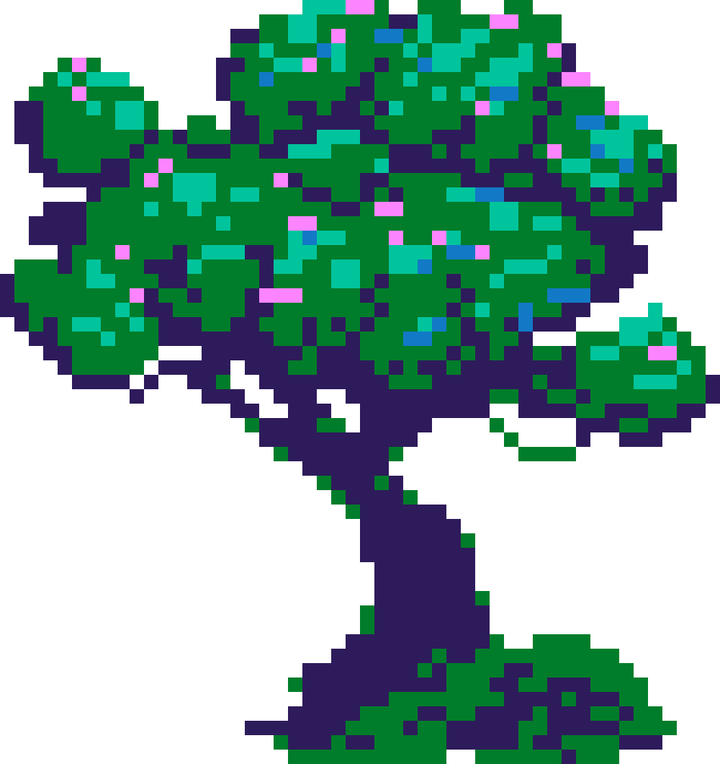
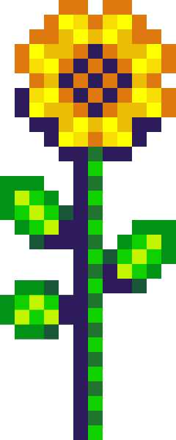

WELCOME TO OUR GAME
A FUN AND INTERACTIVE GUESSING GAME. PLAYERS ANSWER A SERIES OF "YES" OR "NO" QUESTIONS, HELPING THE PROGRAM NARROW DOWN ITS GUESSES TO IDENTIFY THE CORRECT ITEM. IF THE PROGRAM'S GUESS IS WRONG, PLAYERS CAN ENHANCE THE GAME BY TEACHING IT A NEW QUESTION, MAKING IT SMARTER FOR FUTURE ROUNDS.
In the multiplayer challenge, players compete by taking turns answering the questions. When the program fails to guess correctly, the current player earns a point. The game continues until one player emerges as the winner with the highest score. It’s a competitive and collaborative way to enjoy the game while improving its logic!
More Information

Slide 3
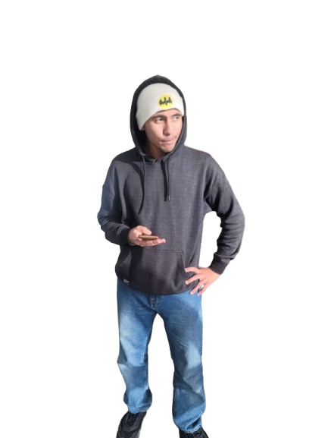
RECURSION
THIS IS OUR FRIEND GOMAA,
HE DOESN’T WANT TO ATTEND THE PROGRAMMING LECTURE AS HE WANTS TO EAT HIS CREPE HE BOUGHT FROM THE NTI CAFETERIA BUT HE IS AFRAID OF FAILIURE AS HE DIDN’T ATTEND ALOT OF LECTURES THIS SEMESTER

Slide 4
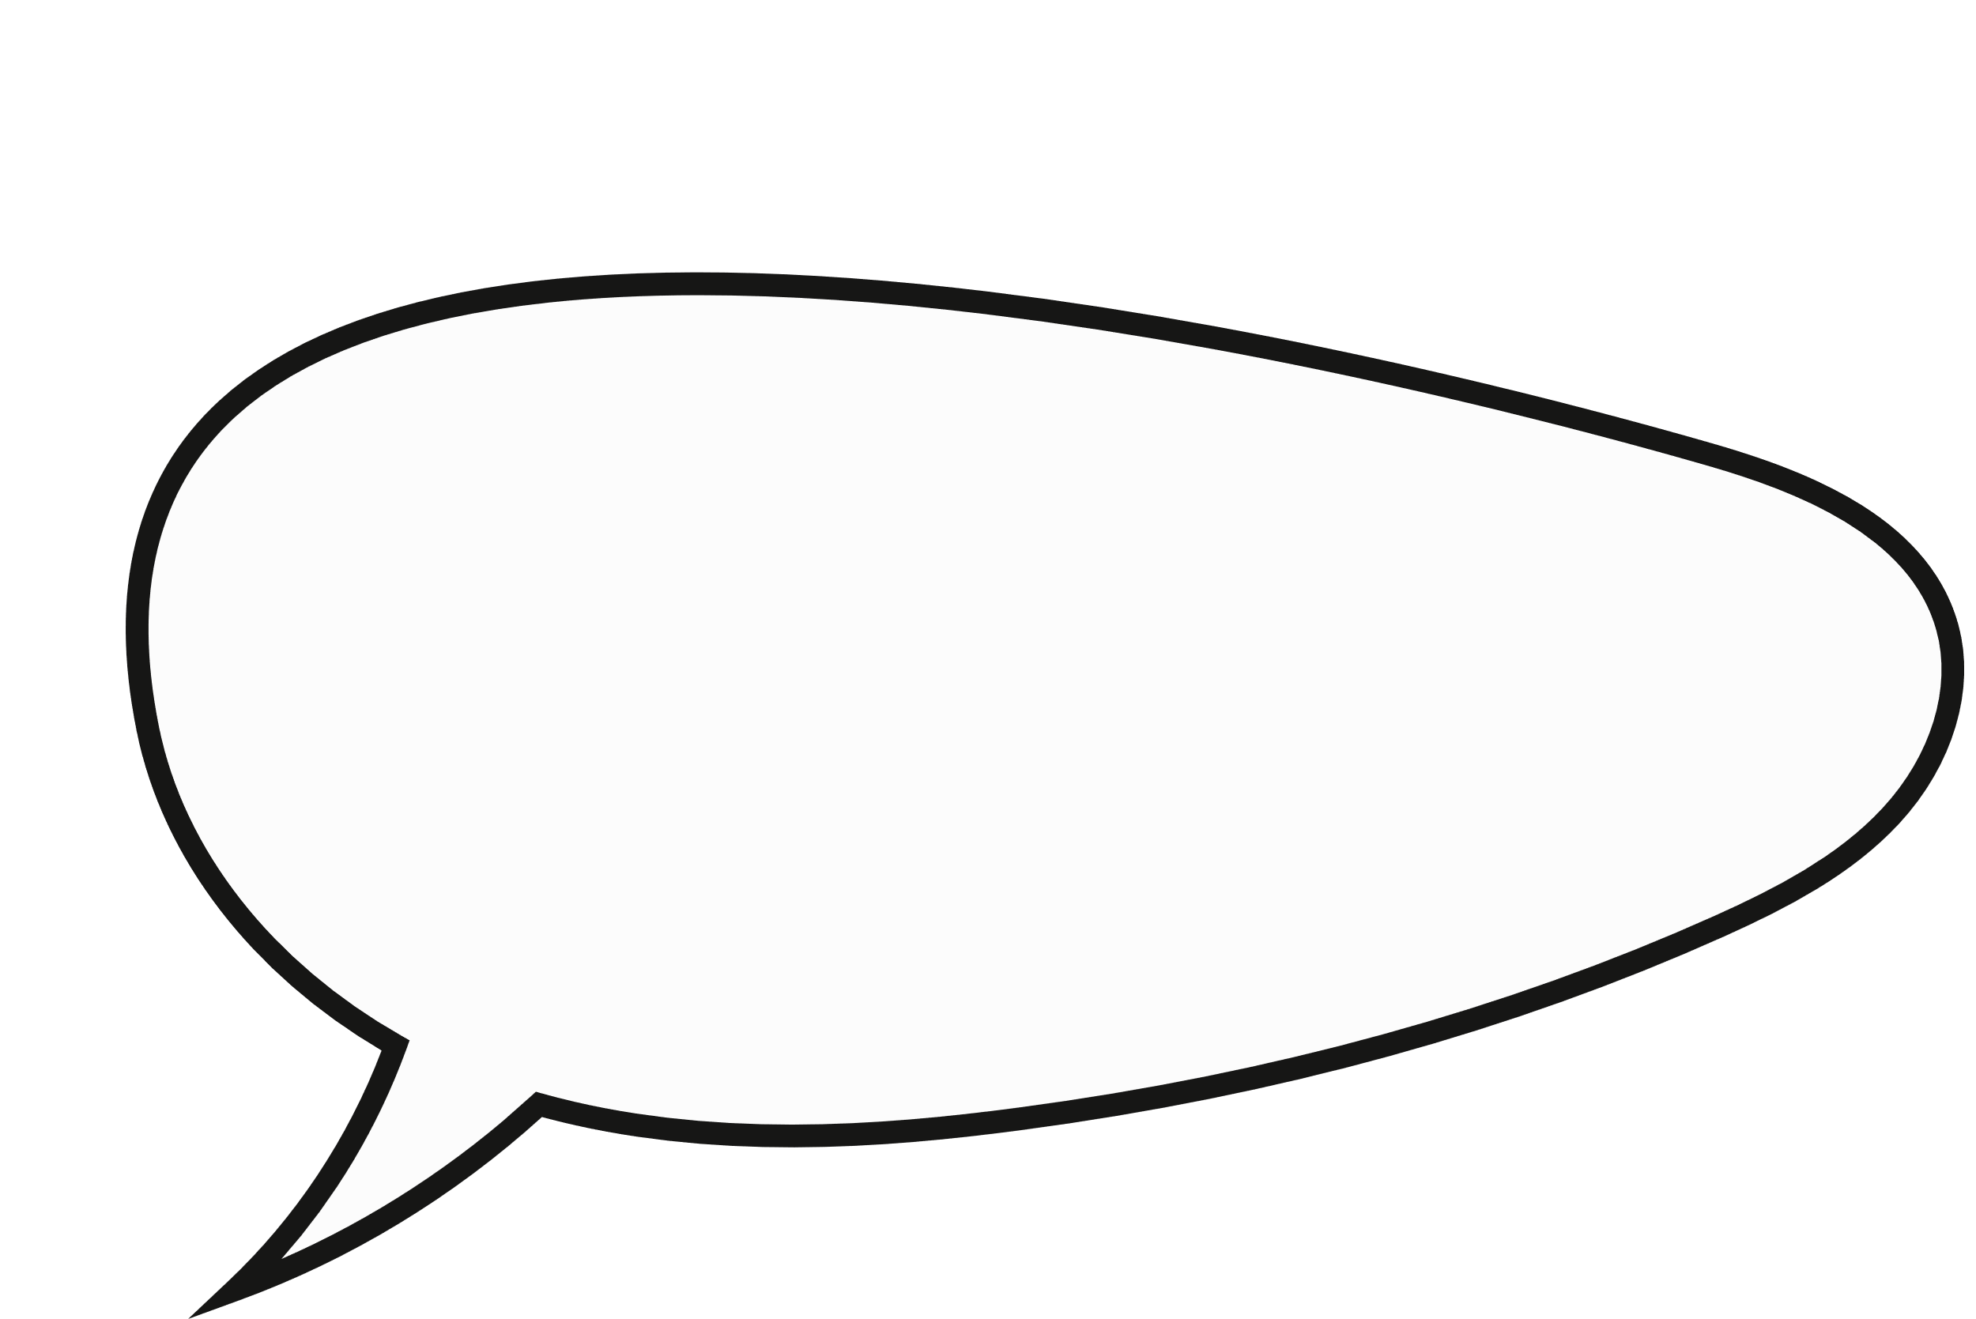

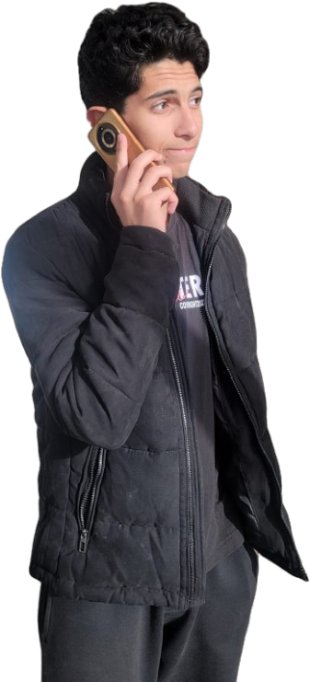
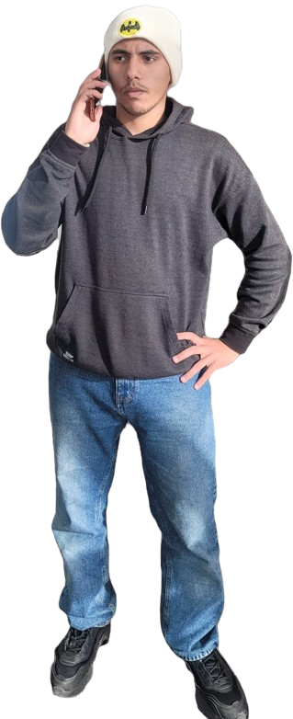
بس انا مش هحضر انا كمان
خدلي الATTENDANCE يا سيف لو سمحت
HE CALLED SEIF TO ASK HIM TO SNEAK HIS NAME IN THE ATTENDANCE PAPER

Slide 5
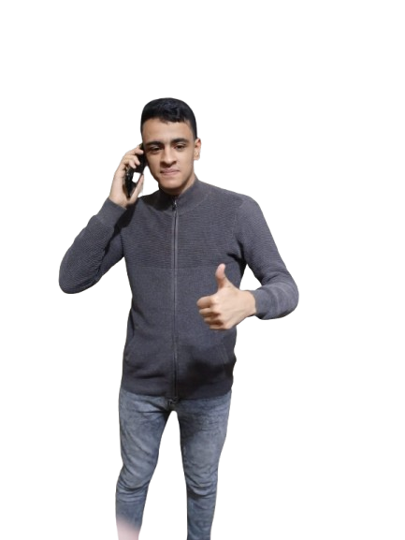
زيتون ممكن تاخدلي انا و جمعه الATTENDANCE
اعتبره حصل يباشا
SEIF CALLED ZAYTOON WHO ATTENDS THE PROGRAMMING CLASS TO SNEAK THEIR NAMES

Slide 6
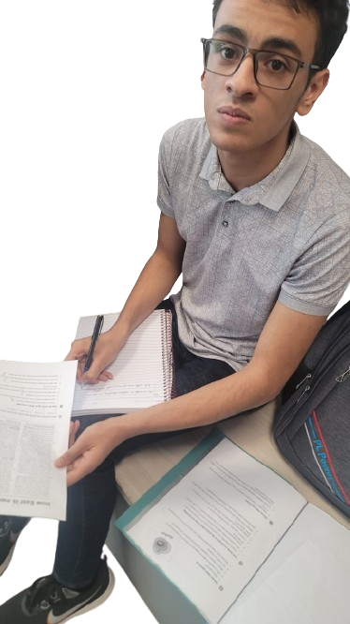
متقوليش لدكتور فاطمة والنبي اخر مرة والله
DR SHAYMAA SAW ZAYTOUN WHILE HE WAS WRITING SEIF AND GOMAA’S NAMES AND HE TRIED TO ESCAPE AND SAY “سيف و جمعة بيصلوا الضهر”
THIS IS OUR BASE CASE WHEN DR SHAYMAA قفشت ZAYTOUN WHILE HE WAS TRYING TO SNEAK HIS FRIENDS’ NAMES AND NOW IT’S TIME TO TELL SEIF AND GOMAA THAT THEY WILL BE PUNISHED WITH HIM

Slide 7
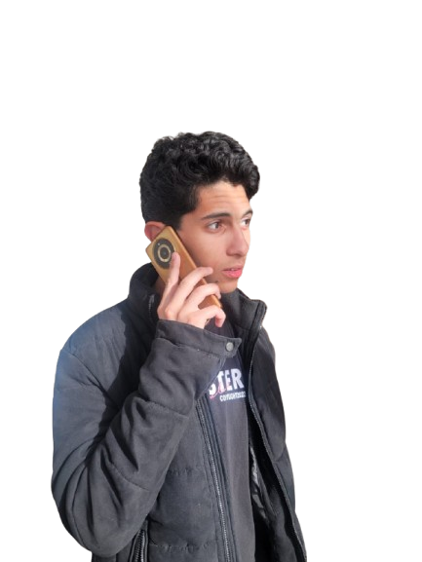
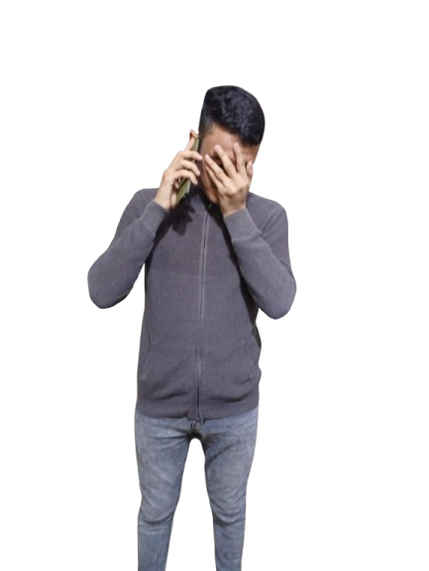

NOW ZAYTOUN TOLD SEIF THAT HE WAS CAUGHT WHILE HE WAS CHEATING THIER ATTENDANCE
اتقفشنا يا ليدر
يلاهوااااااي, اما اروح اقول لجمعة

Slide 8
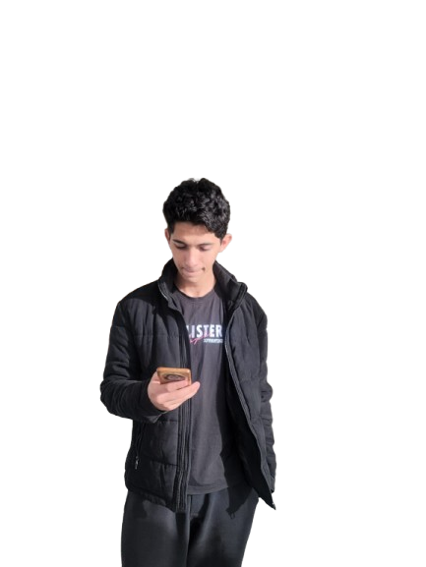
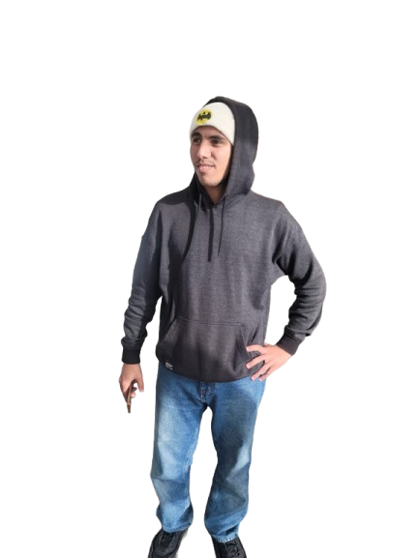
SEIF WILL RETURN THE INFORMATION THAT HE RECEIVED FROM ZAYTOUN TO GOMAA
##@$
زيتون اتقفش يا جمعه

Slide 9
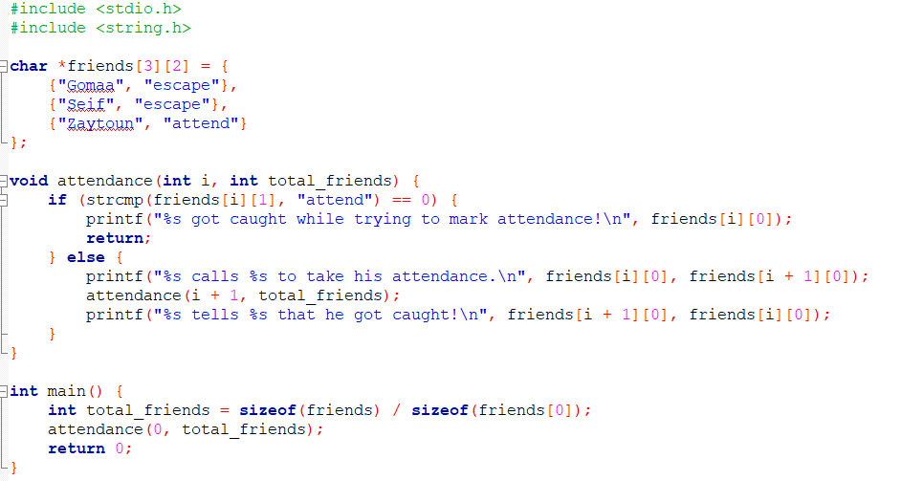
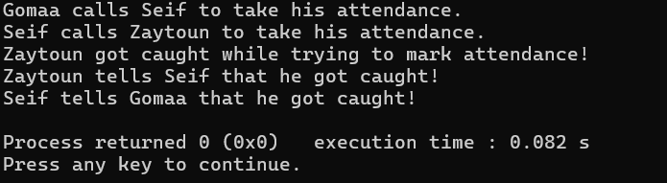
SO HOW CAN WE WRITE THIS AS A CODE

Slide 10
WHAT DO WE LEARN FROM THIS?
RECURSION AND HOW IT WORKS
TO NEVER WRITE YOUR FRIENDS’ NAMES IN THE ATTENDANCE PAPER

Slide 11
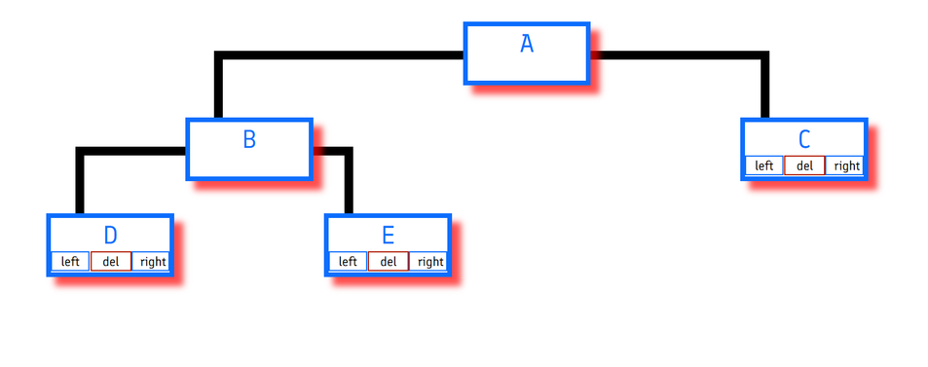
What is a Binary Tree?
DATA STRUCTURE IN WHICH EACH NODE HAS AT MOST TWO CHILDREN
TYPES OF BINARY TREES BASED ON:
NUMBER OF CHILDREN:
FULL BINARY TREE
DEGENERATE TREE
SKEWED TREE
COMPLETION OF LEVELS:
COMPLETE BINARY TREE
PERFECT BINARY TREE
BALANCED BINARY TREE
SOME SPECIAL TYPES OF TREES:
BINARY SEARCH TREE
AVL TREE
B TREE
KEY CHARACTERISTICS:
1. EACH NODE CONTAINS:
DATA (VALUE)
POINTER TO THE LEFT CHILD
POINTER TO THE RIGHT CHILD
2. THE TOPMOST NODE IS CALLED THE ROOT
3. NODES WITH NO CHILDREN ARE CALLED LEAF NODES.

Slide 12
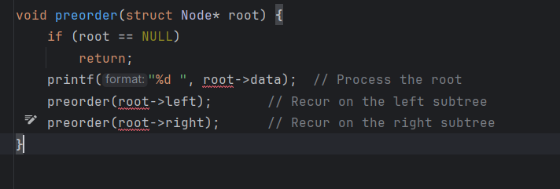
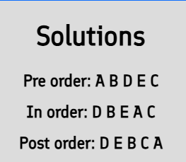
DEPTH FIRST SEARCH (DFS) – PREORDER TRAVERSAL
AN ALGORITHM USED TO TRAVERSE OR SEARCH A TREE OR GRAPH
ROOT-LEFT-RIGHT
THE ROOT NODE OF THE SUBTREE IS VISITED FIRST.
THEN THE LEFT SUBTREE IS TRAVERSED.
AT LAST, THE RIGHT SUBTREE IS TRAVERSED.

Slide 13
GUI
THE LIBRARY USED: RAYGUI WHICH IS A LIBRARY FROM A REAL GAME AND WE FOUND IT ON GITHUB
FUNCTIONS USED:
1.
GUI BUTTON :IT IS STRUCT THAT STORE THE COORINATES OF THE BUTTON AND THE SHAPE OF THE BUTTON
2.
DRAW TEXTURE :IS USED TO DRAW THE BACKGROUND OF THE SCREEN OR TO DRAW ANY FIGURE ON THE SCREEN
3.
DRAW TEXT :IS A STRUCT USED TO DISPLAY THE STRING STORED IN IT AND IT ALSO CARRY THE COORDINATES OF THE STRING STORED
4.
LOADMUSICSTRAM :IS USED TO LOAD THE MUSIC INTO VARIABLE WITH MUSIC DATA TYPE
5.
LOAD TEXTURE:IS USED TO LOAD THE PHOTO ]IN VARIABLE WITH TEXTURE DATA TYPE

Slide 14
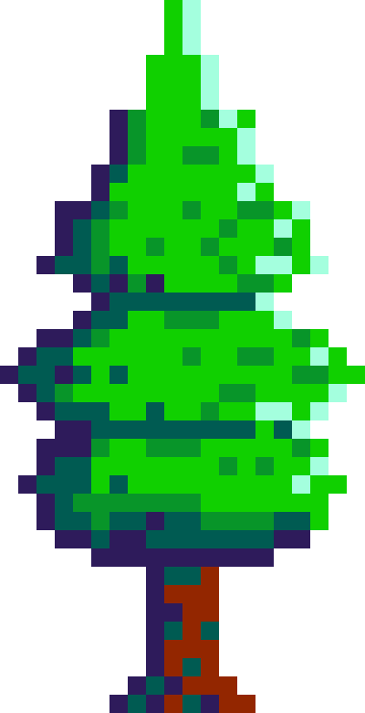

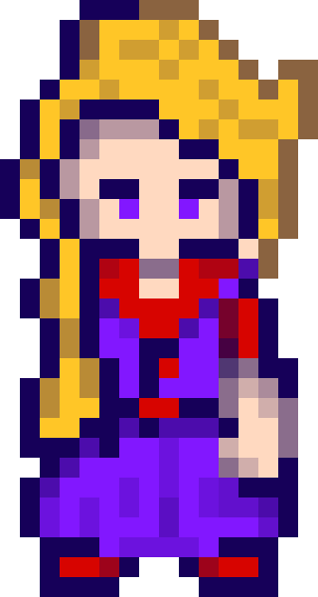
USER MANUAL
01
Course guess
The game has 5 modes to play
02
Country guess
03
Programming guess
04
Club guess
05
Car guess

Slide 15

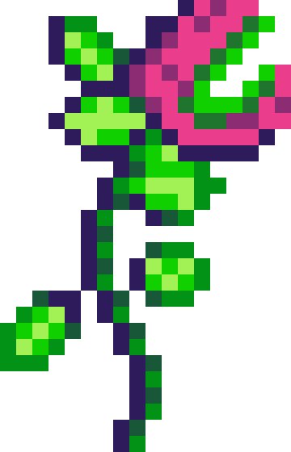
FEATURES OF THE GAME CODE
01
Multiplayermode
02
Undo Button
03
Timer
04
Diffrent game categories
05
Create new game
06
Modify and update the tree file

Slide 16
GUIDELINES
The user chooses between solo and mutliplayer mode by entering 1 or 2 and entering 0 to quit
The user enters a number from 1 to 5 to choose a game mode of: course, country, programming language, football and cars.
Or he can enter 6 to create his own game.
01
02
The user answers with “yes” or “no” or “undo” for returning back to previous question
After finishing the game the user can enter 0 to quit, 1 to print the questions as a tree, 2 to restart with the same mode in solo, 3 to restart in solo, 4 to restart in mutliplayer
03
04
If the user chose the multiplayer mode he will need to enter how many player are playing
In the multiplayer mode: each player got 3 rounds trying to defeat the guessing game and the one with higher points wins
05
06

Slide 17
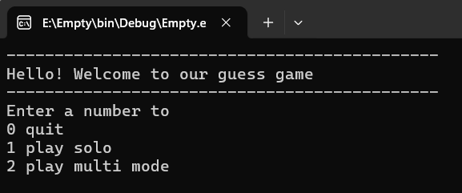
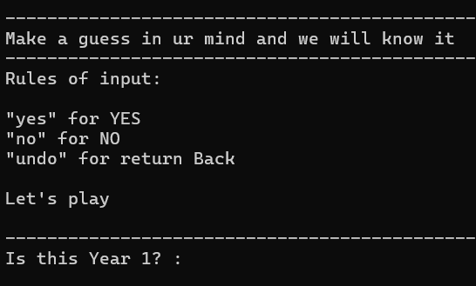
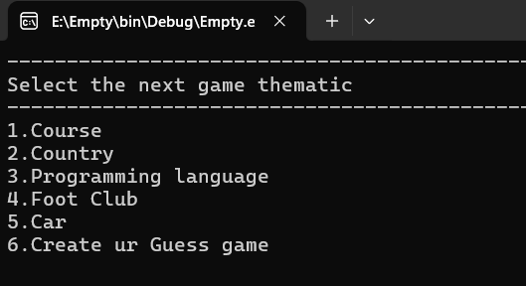
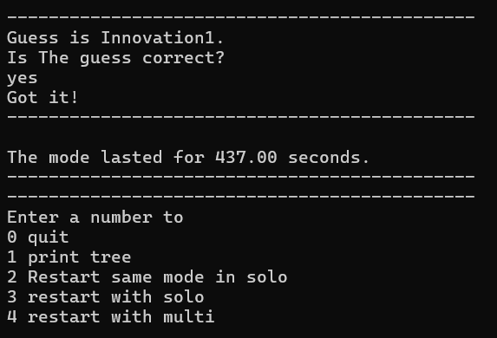
SCREEN SHOTS FROM THE TERMINAL
1
3
1 - THE FIRST OUTPUT TO PROMPT THE USER TO ENTER THE MODE
3 - HERE WE TELL THE USER HOW CAN HE PLAY AND ASK HIM QUESTIONS
2
4
2 - HERE WE ASK THE USER WHICH THEME HE WANTS TO GO THROUGH
4- IF THE GUESS IS CORRECT THE GAME WILL CONGRATULAGTE ITSELF AND TELL THE USER HOW LONG IT TOOK, THEN ASK HIM IF HE WANT TO PLAY AGAIN

Slide 18
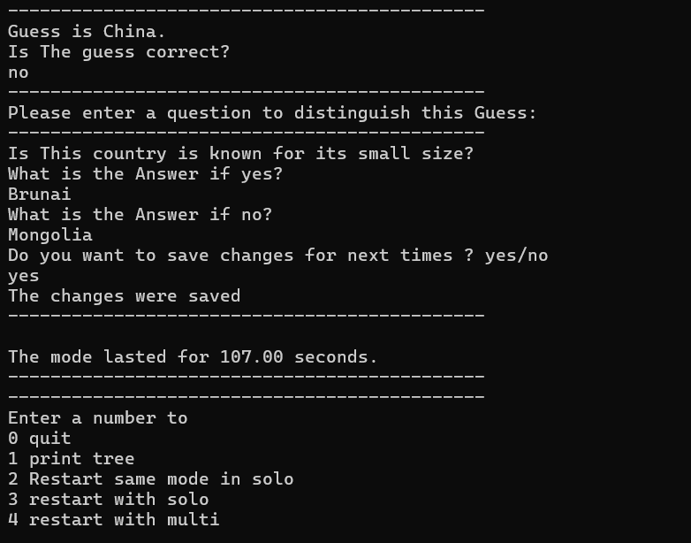
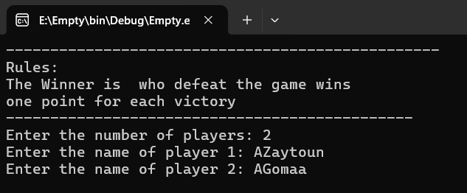
6
5
5- IF THE GUESS WAS INCORRECT THE GAME WILL ASK THE USER TO WRITE A QUESTION TO UPDATE THE TREE AND MAKE THE GAME KNOW HOW TO RESPOND IF SOMEONE THOUGHT ABOUT THE SAME THING
6 - IF THE USER WANTED TO PLAY MULTIPLAYER MODE THE FIRST THING THAT WILL COME OUT IS THE GAME ASKING THE USER TO SAY HOW MANY PLAYERS ARE PLAYING THEN IT WILL ASK THE USER TO TYPE THE NAMES OF THE PLAYERS
7

Slide 19
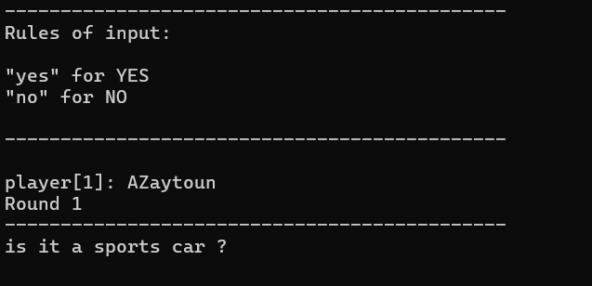
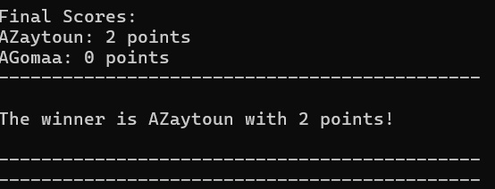
8
7- PLAYER ONE GETS 3 ROUNDS AND THE GAME COULDN’T GUESS THE PLAYER GETS 1 POINT AND THE SAME GOES TO PLAYER 2
8 - THE FINAL SCORES OF THE MATCH APPEAR AND THE GAME WILL CONGRATULATE THE WINNER

Slide 20
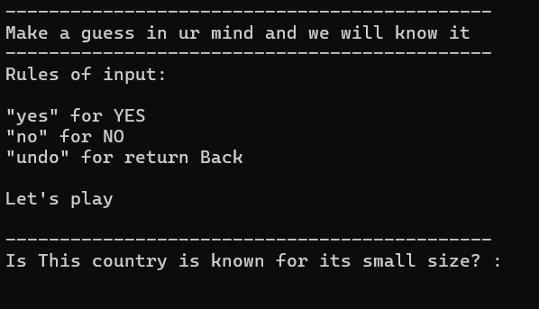
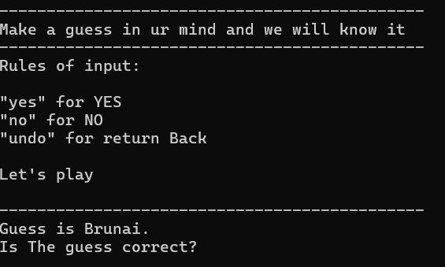
NOW LETS TEST THE APP TO SEE IF IT LEARNED FROM ITS MISTAKE
NOW ITS ASKING ME THE QUESTION I TAUGHT IT
YAYYYY, OUR GAME IS A FAST LEARNER

Slide 21
FEATURE OF THE GAME GUI
01
Multiple modes in the games each mode with its own theme and background music
02
Many buttons to facilitate the interaction of the user with the game and emoji to interact with user
03
An undo button to make the user return to the previous question in case changing the answer
The ability for the user to add questions with answers in case of yes and no to modify the file and add information and the user can choose to save the modification for the next time
04
05
Dynamic gui tree printing
the ability to show the player stats with the number of questions and number of answered yes and answered no
06

Slide 22
RULES FOR GUI
01
INCLUDE RAYGUI HEADER
SO YOU CAN ENJOY OUR GAME EXPERIENCE
MAKE SURE TO MAKE PHOTOS AND MUSIC IN SAME DIRECTORY
02
MAKE SURE THAT FILES ARE IN SAME DIRECTORY
03
CHANGE THE PATHS OF FILES AND IMAGES ACCORDING TO DEVICE
04

Slide 23
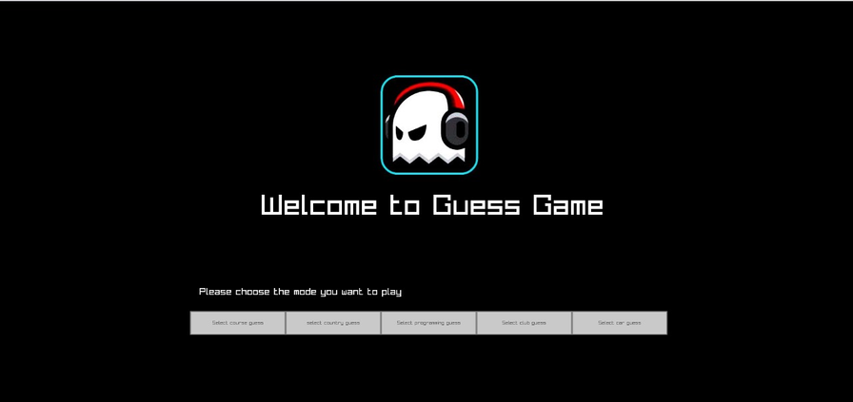
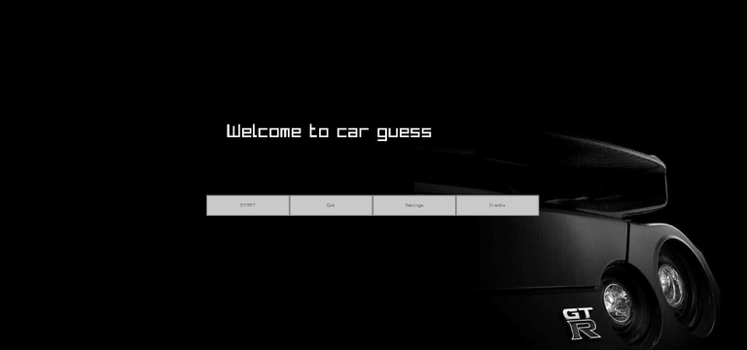

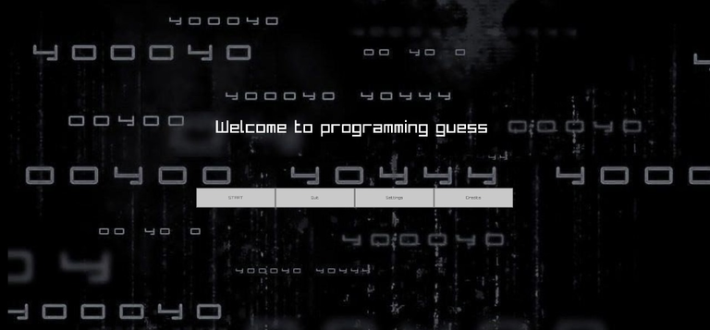
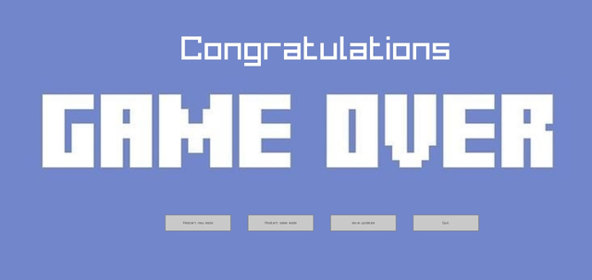
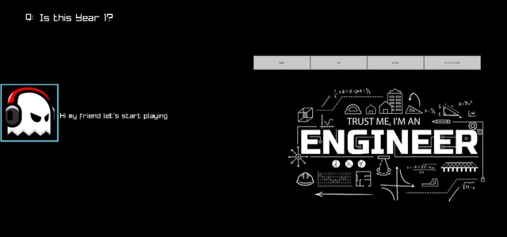
SCREEN SHOTS FROM THE GUI
START SCREEN
CAR GUESS MODE
CLUB GUESS MODE
PROGRAMMING GUESS MODE
COUSRE GUESS MODE
GAME OVER SCREEN
EMOJI TO INTERACT WITH USER

Slide 24
CONTRIBUTIONS
SEIF HAYTHEM:
Link GUI with code-Themes and music-Interactive emoji-Traversing in questions , answers, screens and modes-updating the tree - Presentation - GUI video - car file making
ZIAD MOHAMED :
creating the cmake and header for the gui-creating the settings screen and main screen -printing the file tree-participated in linking gui with the code , Poster
01
02
Abdelrhman gomaa
Overall supervision over the program
Play the game from start to making guess
video editing
Ahmed Zaytoun:
players' stats in GUI
Multiplayer mode
Doucmentation 1
Timer
03
04
Moataz Ashraf
Undo feature ( using stack)
Learning process of the program and updating the tree
poster
programing language file making
Hassan ahmed
Construction of tree from file
and update the file (File Handling)
Create new guess game feature
Report documentation
Courses file making
05
06

Slide 25

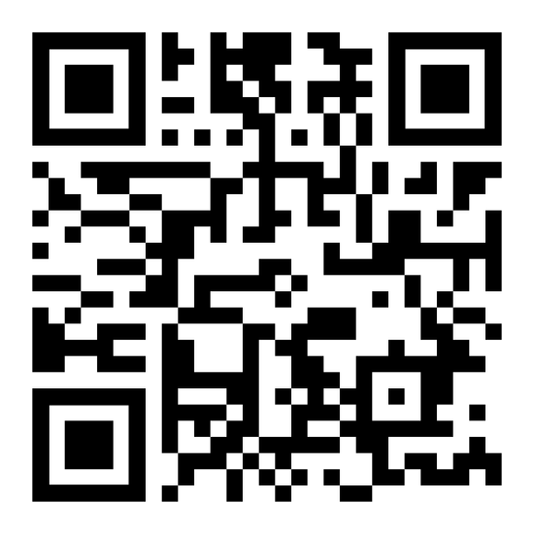

REFRENCES

Slide 26


THANKYOU

